Slide 1


Strategies for Profitability and Market Share in India
Name- Gaurav Kumar Singh
College – IIT Hyderabad
Email- bm22mtech11002@iith.ac.in
Contact – 9304222911

Slide 2
Contents
Introduction to Perfora
Perfora's Rapid Growth
Perfora's Distribution Strategy
Increasing Profitability
Continuing with D2C Model
Brick-and-Mortar Distribution Strategy
Challenges of Brick-and-Mortar
Hybrid Distribution Strategy
Implementation Plan
Conclusion

Slide 3

Introduction to Perfora
Perfora is an innovative oral care brand that has taken the Indian market by storm.
With its digital-first approach, Perfora has revolutionized the way people think about oral hygiene.
By leveraging the power of e-commerce and social media, Perfora has successfully reached millions of consumers across India.
Recently, Perfora was featured on Shark Tank India, where it impressed the judges with its unique products, innovative marketing strategies, and impressive sales figures.
This exposure has helped Perfora gain even more traction in the market and has solidified its position as a leading player in the oral care industry.

Slide 4
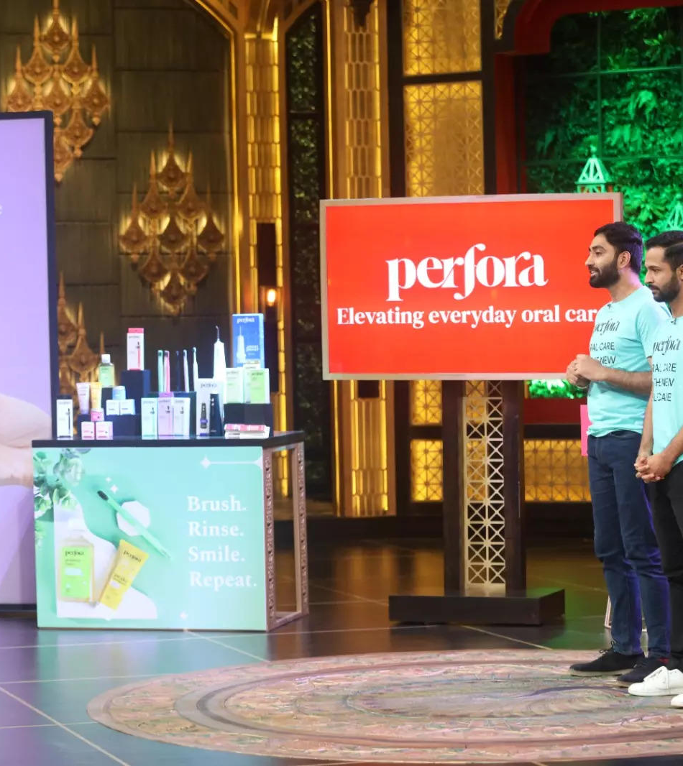
Perfora's Rapid Growth
In just 9 months, Perfora has experienced an incredible surge in sales, growing from 70 lakhs per month to 3.5 cr per month.
This rapid growth can be attributed to a number of factors, including the brand's focus on digital-first marketing and its commitment to providing high-quality oral care products at affordable prices.
Perfora's success on Shark Tank India also played a significant role in its rapid growth, as it helped to increase brand awareness and credibility among consumers.
With its innovative products and strong marketing strategy, Perfora is well-positioned to continue its upward trajectory in the Indian market.

Slide 5
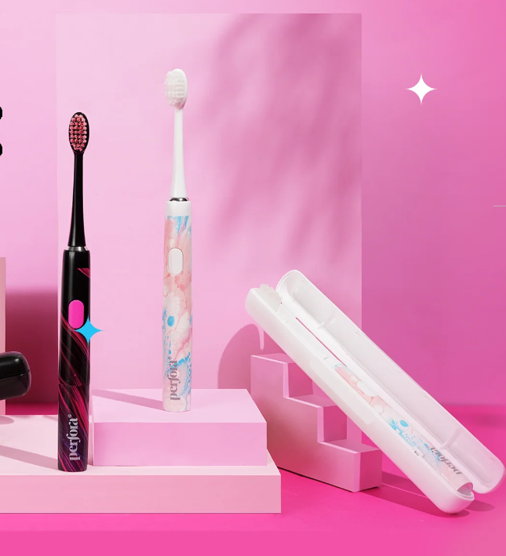
Perfora's Distribution Strategy
Perfora's distribution strategy is a multi-pronged approach that leverages both digital and offline channels.
Currently, the brand sells its products through its D2C website, as well as other online marketplaces such as Amazon and Flipkart.
In addition, Perfora has also reached 300 offline stores, including pharmacies and supermarkets.
The brand's offline presence has been particularly successful in reaching customers in smaller towns and cities, where e-commerce penetration may be lower.
By partnering with established retailers, Perfora has been able to tap into existing distribution networks and reach a wider customer base.

Slide 6

Increasing Profitability
One way for Perfora to increase profitability and market share in India is by expanding its product line.
By introducing new products that complement its existing offerings, Perfora can attract new customers while also increasing sales from its existing customer base.
This can be achieved through market research and identifying gaps in the oral care market that Perfora can fill.
Another strategy for increasing profitability is by improving customer retention. By providing exceptional customer service and offering loyalty programs or discounts to repeat customers, Perfora can encourage customers to continue purchasing its products.
This can also lead to positive word-of-mouth marketing and increased brand awareness.

Slide 7
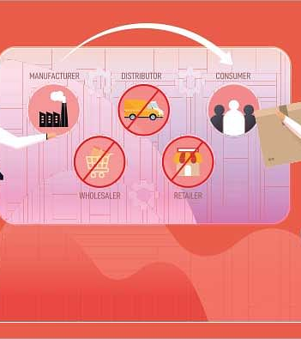
Continuing with D2C Model
Perfora's current D2C model has several benefits, including reduced costs and increased control over the customer experience.
By selling directly to customers through its website, Perfora can avoid the costs associated with traditional retail, such as rent, utilities, and employee salaries.
This allows the company to offer competitive prices and still maintain healthy profit margins.
Additionally, by controlling the entire customer experience from start to finish, Perfora can ensure that every interaction with the brand is positive and consistent.
From the website design to the packaging of the products, every detail is carefully considered to create a seamless and enjoyable experience for the customer.

Slide 8
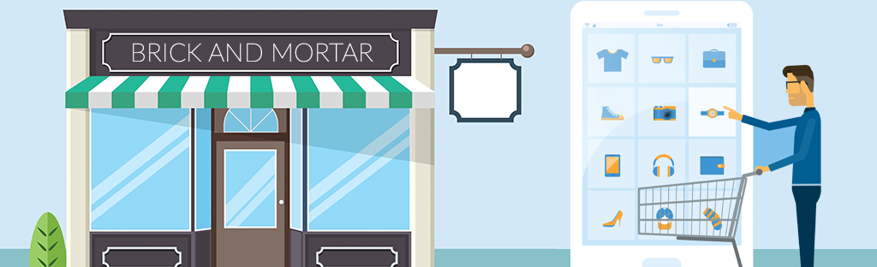
Brick-and-Mortar Distribution Strategy
Implementing a brick-and-mortar distribution strategy can bring significant benefits to Perfora.
By opening physical stores, the brand can increase its visibility and reach a wider customer base.
This can be particularly beneficial in areas where online shopping is not yet popular or trusted.
In addition, brick-and-mortar stores can provide customers with a more tactile and immersive experience, allowing them to try out products before making a purchase.
Moreover, brick-and-mortar stores can help build trust and credibility for the brand.
By having a physical presence, Perfora can establish itself as a reliable and trustworthy brand in the eyes of consumers.
This can be especially important for a new brand like Perfora, which may still be building its reputation in the market.

Slide 9

Challenges of Brick-and-Mortar
Implementing a brick-and-mortar distribution strategy can be a daunting task for any company, and Perfora is no exception.
One of the biggest challenges is the increased costs associated with opening physical stores, such as rent, utilities, and staffing.
This can put a strain on the company's finances, especially if sales don't immediately meet expectations.
Another challenge is the need for strong partnerships with retailers. While partnering with established retailers can provide access to a wider customer base, it also requires a significant investment in building relationships and negotiating terms.
Additionally, retailers may have their own demands and requirements that could conflict with Perfora's goals and values.

Slide 10
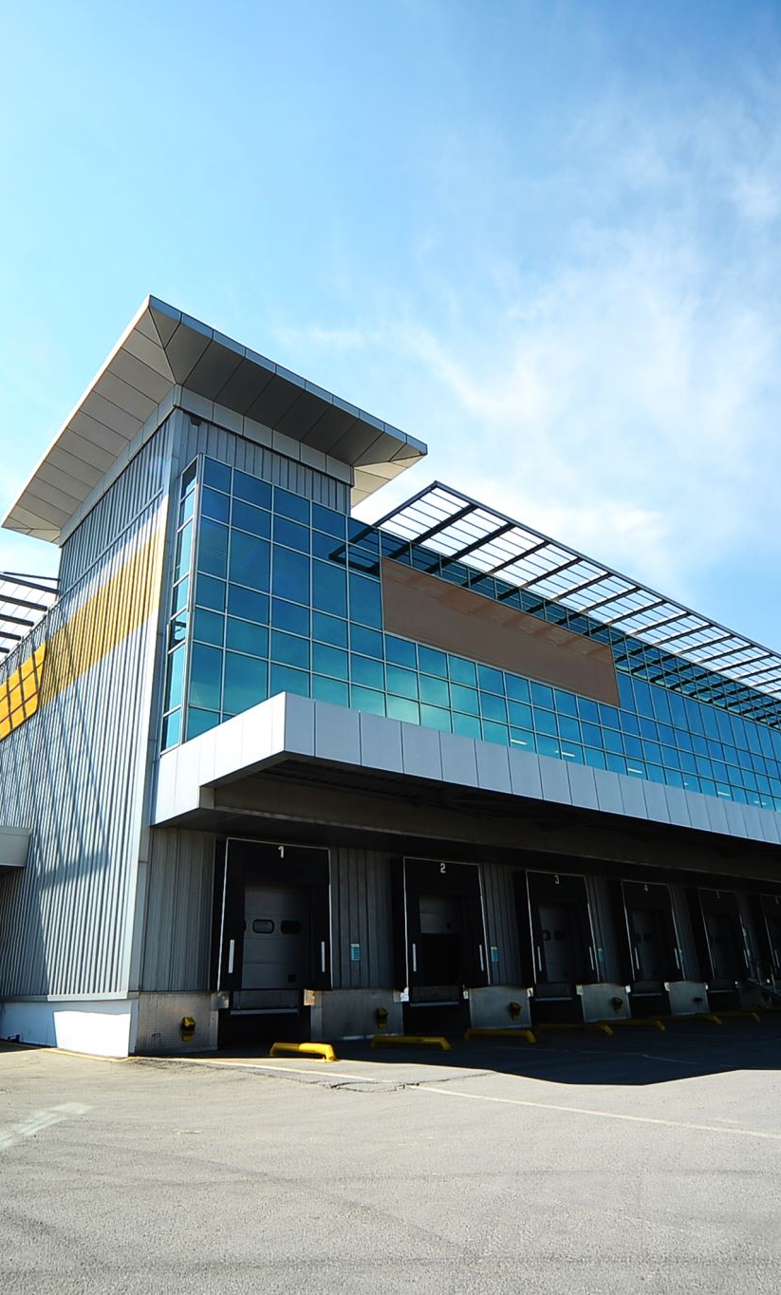
Hybrid Distribution Strategy
Perfora's hybrid distribution strategy combines the benefits of both D2C and brick-and-mortar models.
By opening flagship stores, Perfora can provide customers with a physical location to experience their products and receive personalized recommendations from knowledgeable staff.
Partnering with select retailers also allows for increased visibility and access to a wider customer base.
This strategy addresses the limitations of both D2C and brick-and-mortar models. While D2C offers reduced costs and increased control over the customer experience, it may limit Perfora's reach to customers who prefer to shop in-store.
On the other hand, brick-and-mortar distribution can be costly and requires strong partnerships with retailers.
A hybrid model allows Perfora to leverage the strengths of both models while mitigating their limitations.

Slide 11
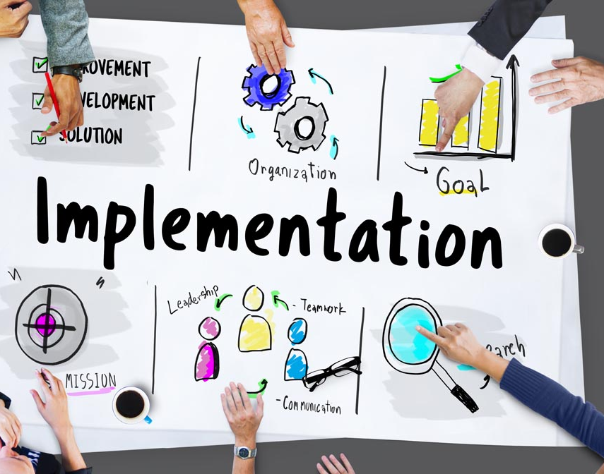
Implementation Plan
To implement the suggested hybrid distribution strategy, Perfora will first need to identify key locations for flagship stores and select retail partnerships. This will involve market research and analysis of consumer behavior to determine the most profitable areas for physical storefronts.
Once locations have been identified, Perfora will need to allocate a budget for store design, construction, and staffing. The timeline for opening flagship stores will depend on the availability of real estate and the speed of construction, but should aim to open within the next 12-18 months.
In addition to physical storefronts, Perfora can also partner with select retailers to expand its reach and increase visibility. These partnerships will require careful negotiation and collaboration to ensure that both parties benefit from the arrangement. Perfora should aim to establish partnerships with retailers in high-traffic areas with a strong customer base.
Overall, the implementation of a hybrid distribution strategy will require significant investment and planning. However, the potential benefits of increased visibility and access to a wider customer base make it a worthwhile endeavor for Perfora.

Slide 12


Conclusion
In conclusion, we have explored the rapid growth and distribution strategy of Perfora, a digital-first oral care brand. With impressive sales growth from 70 lakhs per month to 3.5 cr per month in just 9 months, Perfora has proven its potential in the Indian market. Currently, the brand sells its products through its D2C website and other online marketplaces, and has also reached 300 offline stores.
To increase profitability and market share in India, we suggest a hybrid distribution strategy that combines the benefits of both D2C and brick-and-mortar models. This can be achieved by opening flagship stores and partnering with select retailers. While there are challenges associated with implementing a brick-and-mortar distribution strategy, such as increased costs and the need for strong partnerships with retailers, the potential benefits include increased visibility and access to a wider customer base.

Slide 13

Thank you

Slide 14

Connect me on social media
Linkedin-
https://www.linkedin.com/in/gaurav-kumar-singh-72b8921b7/
Instagram
http://instagram.com/grv_gaurav_singh/

